Slide 1
Chinese Restaurant Localities in New York City
By Ethan Brill

Slide 2
Introduction
What major parts of New York City have the most Chinese Restaurants?
What parts of New York City have the least?
Where should new migrants look to move when moving to NYC?

Slide 3
Data
Latitude and Longitude of Boroughs and Neighborhoods in New York City
Chinese Restaurants in NYC

Slide 4
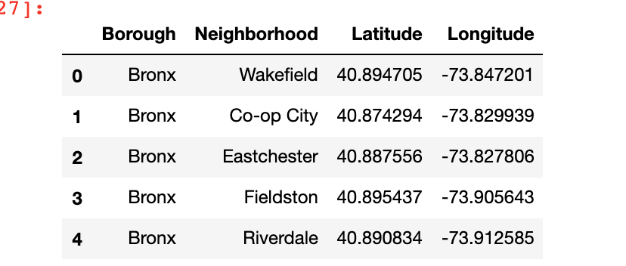
Results:
Latitudes and Longitudes

Slide 5
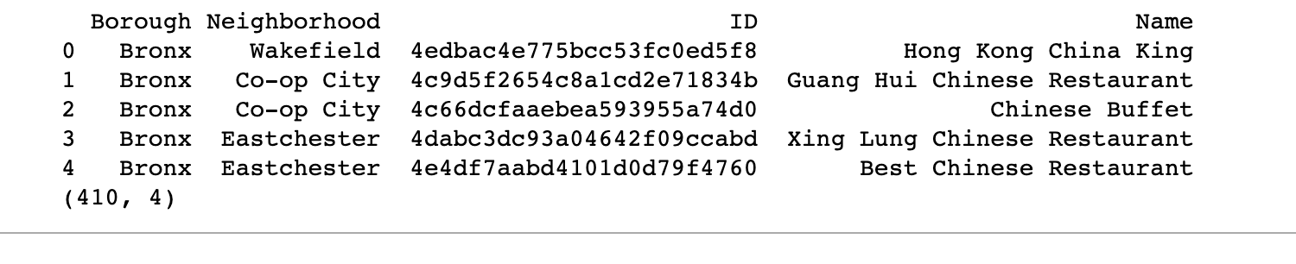
Total List of Chinese Restaurants

Slide 6
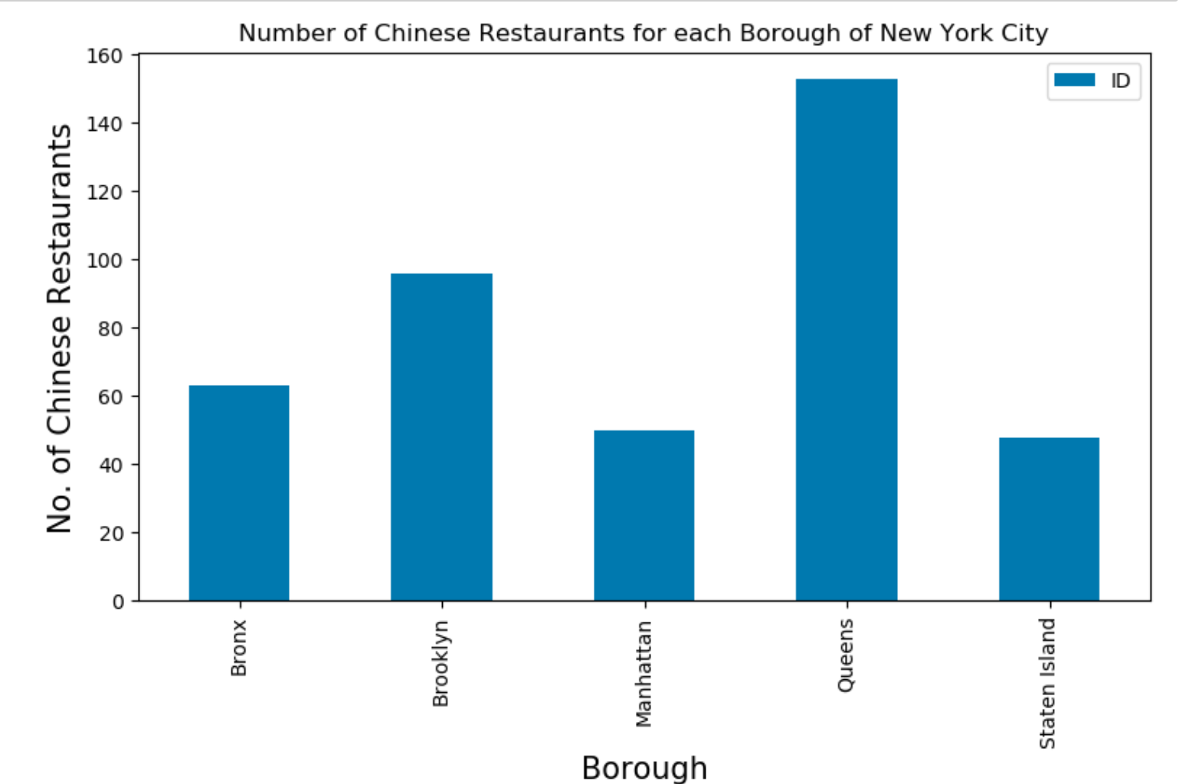
Most restaurants per Borough

Slide 7
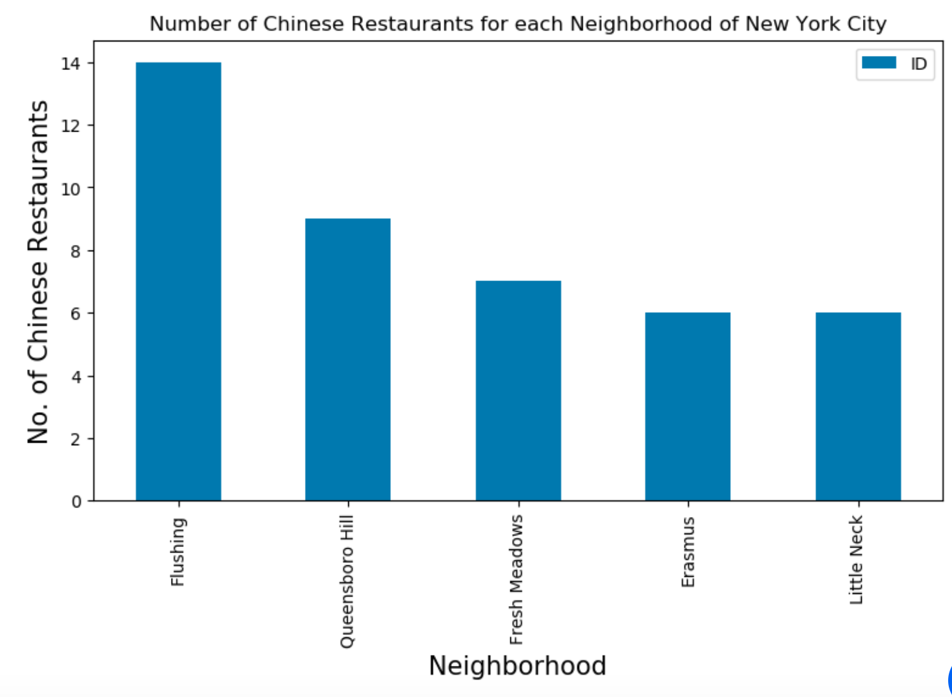
Most restaurants per Neighborhood

Slide 8
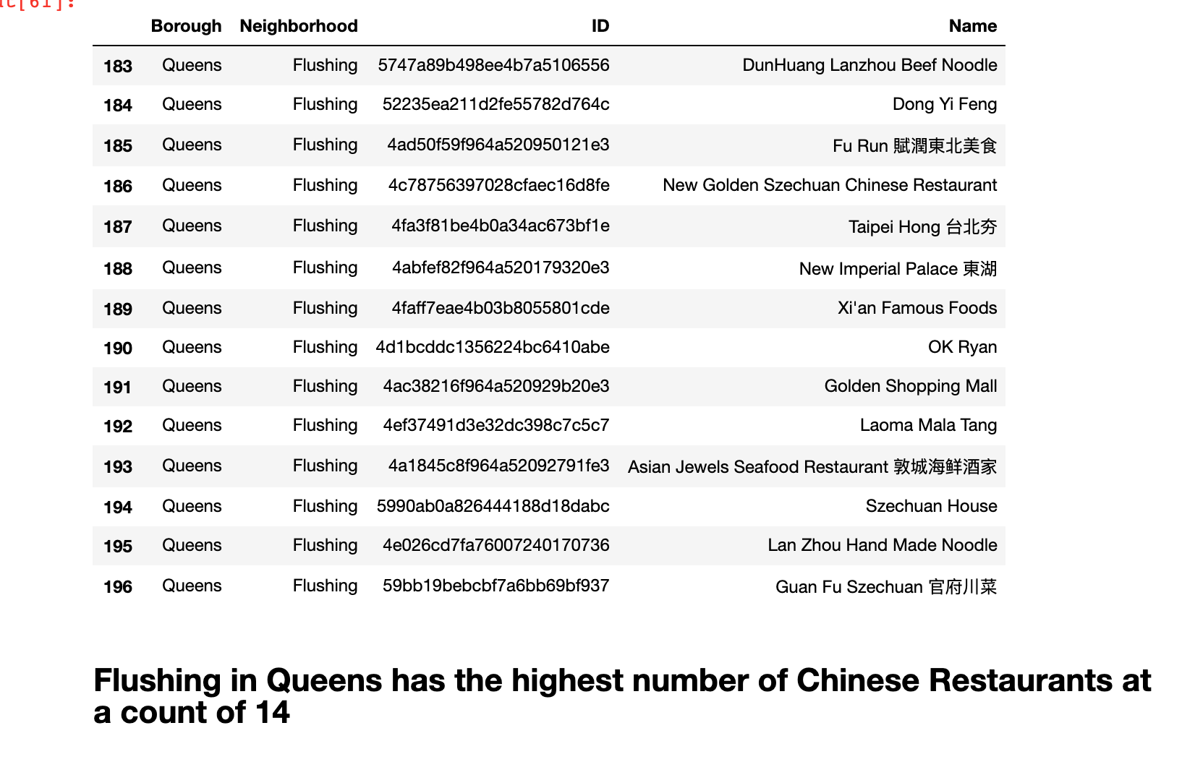
List of Flushing Restaurants

Slide 9
Conclusion
From our analysis, we find that Flushing is the NYC neighborhood with the most Chinese restaurants.
Future directions include analyzing areas with the most Chinese storefront names

